Slide 1

Optimizers from Scratch

Slide 2
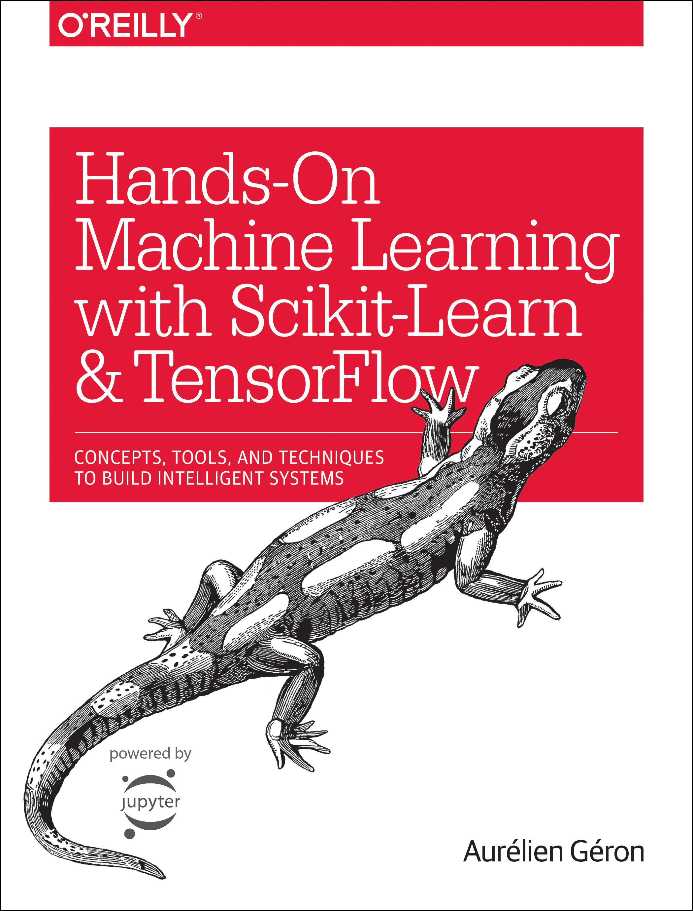
Reference
Chapter 9 (O'Reilly) of Hands-On ML
Youtube on (Manual) Gradient Descent
Youtube on (Auto) Gradient Descent
Youtube
Code

Slide 3
Data

Slide 4
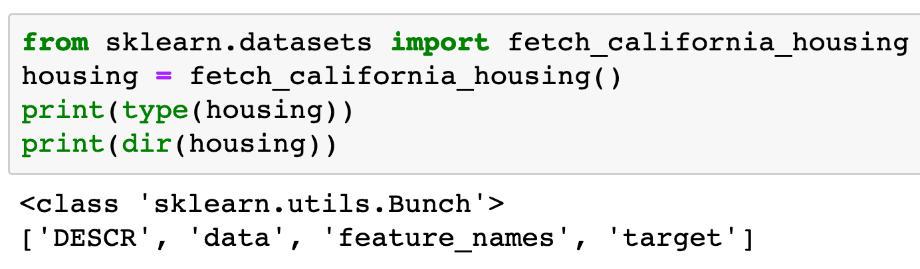

Slide 5
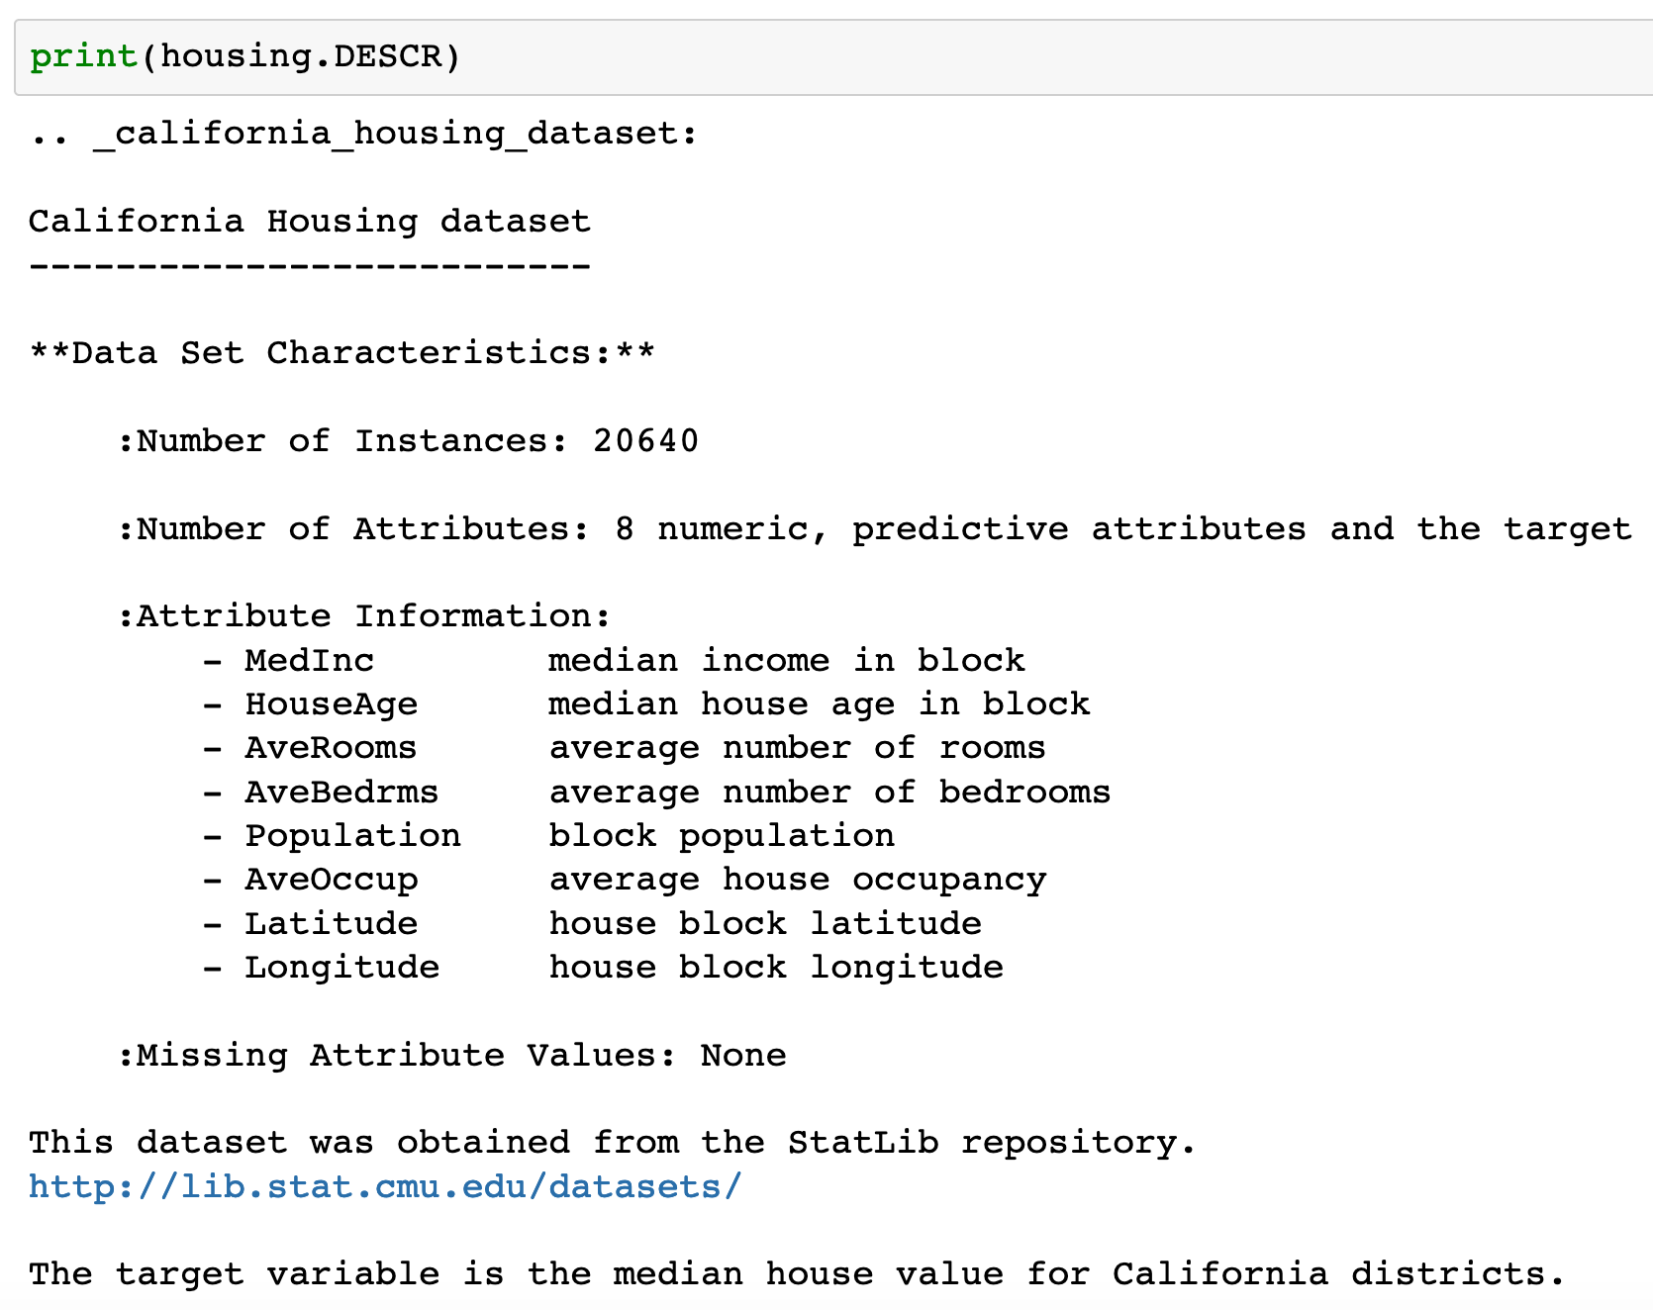

Slide 6
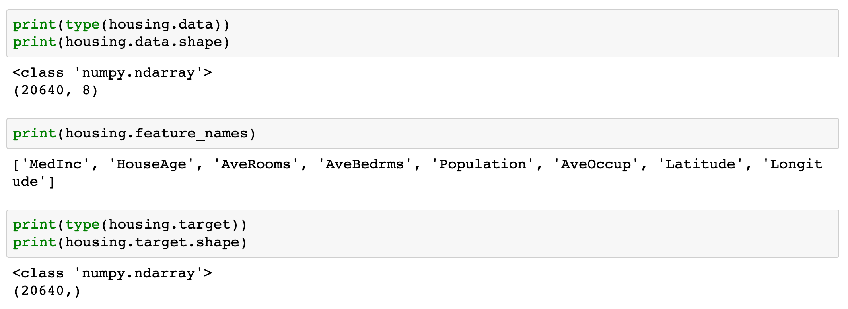

Slide 7
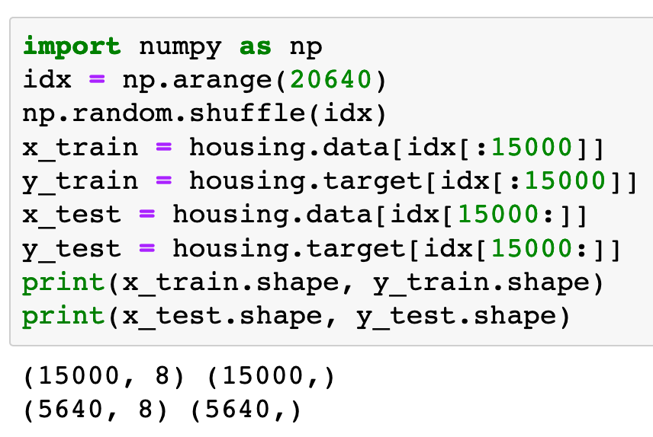

Slide 8
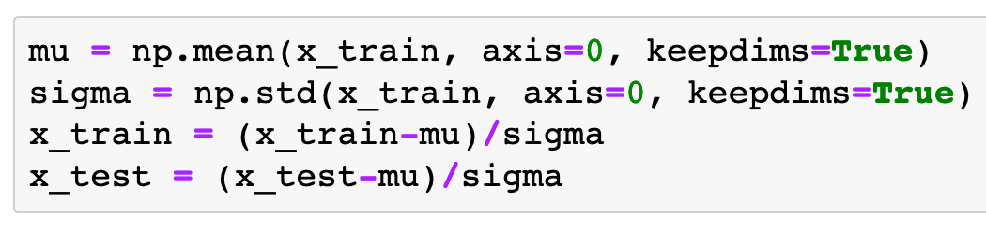
Input Normalization

Slide 9
Warm Up

Slide 10
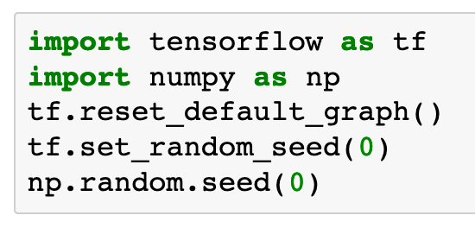

Slide 11
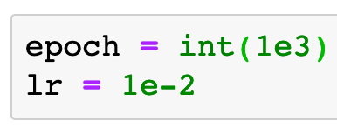

Slide 12
Graph

Slide 13
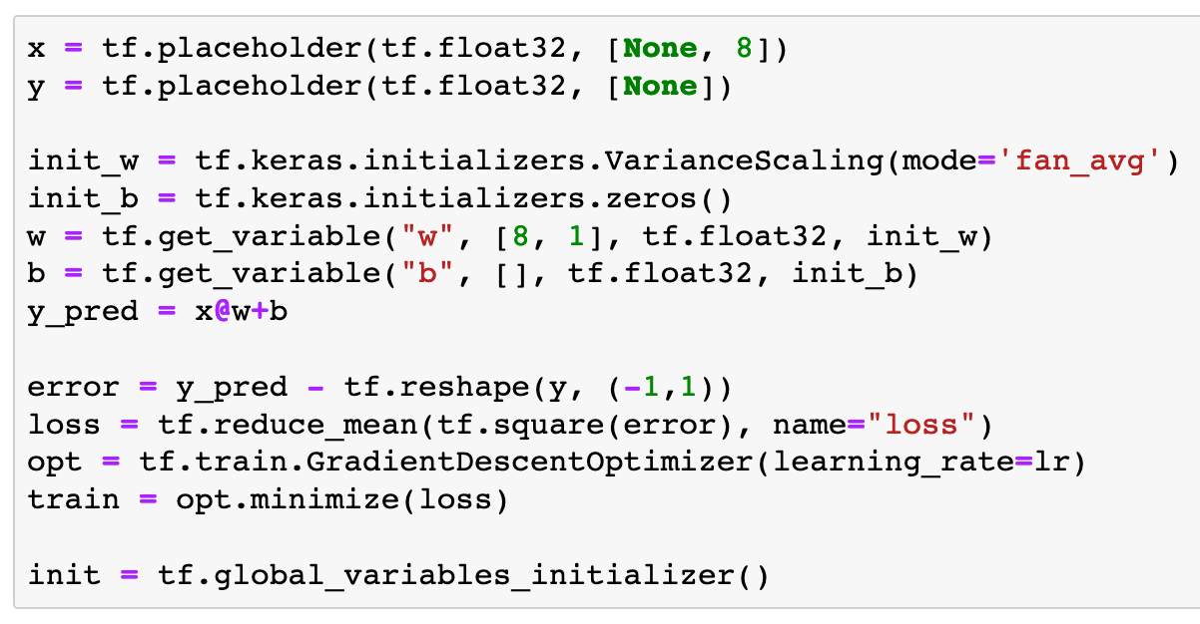
tf.train.GradientDescentOptimizer

Slide 14
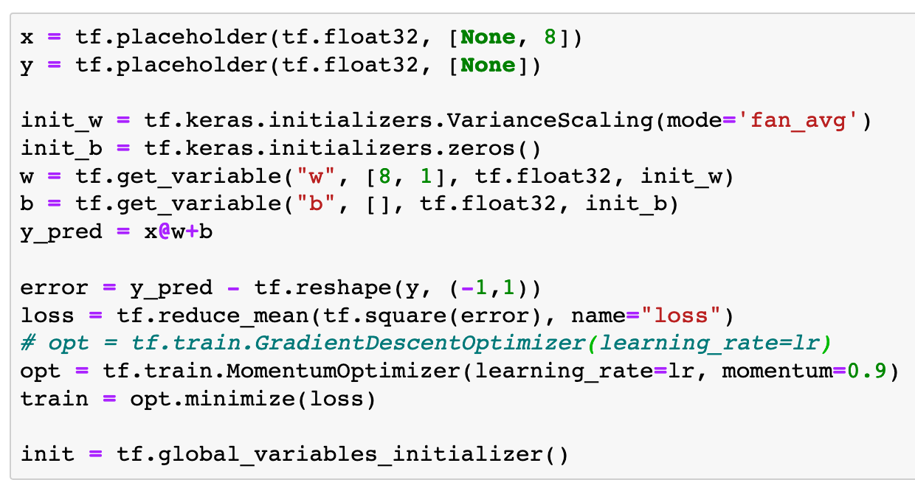
tf.train.MomentumOptimizer

Slide 15
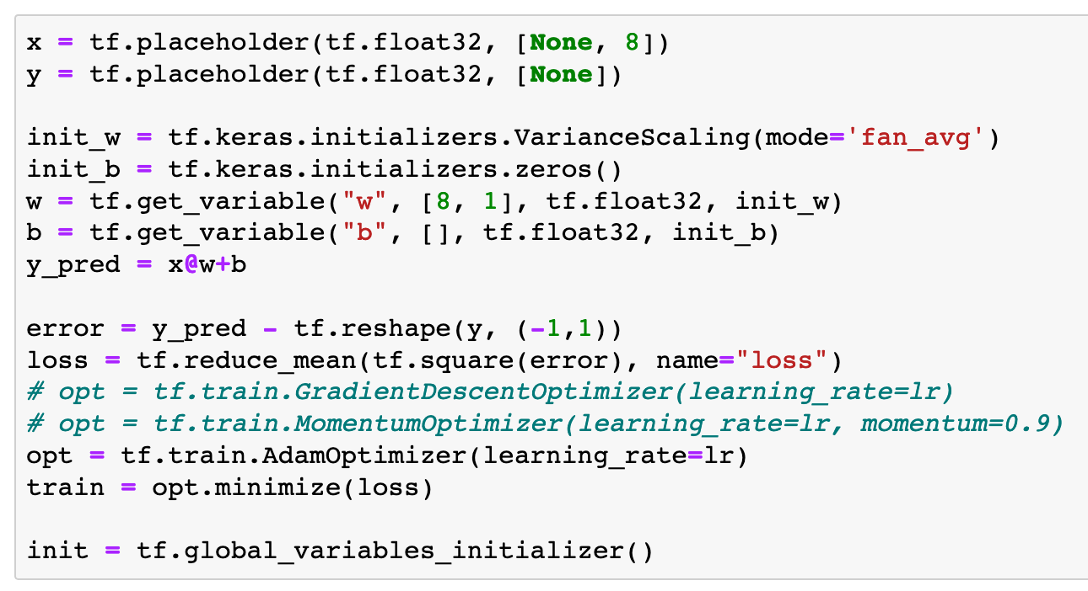
tf.train.AdamOptimizer

Slide 16
Session

Slide 17
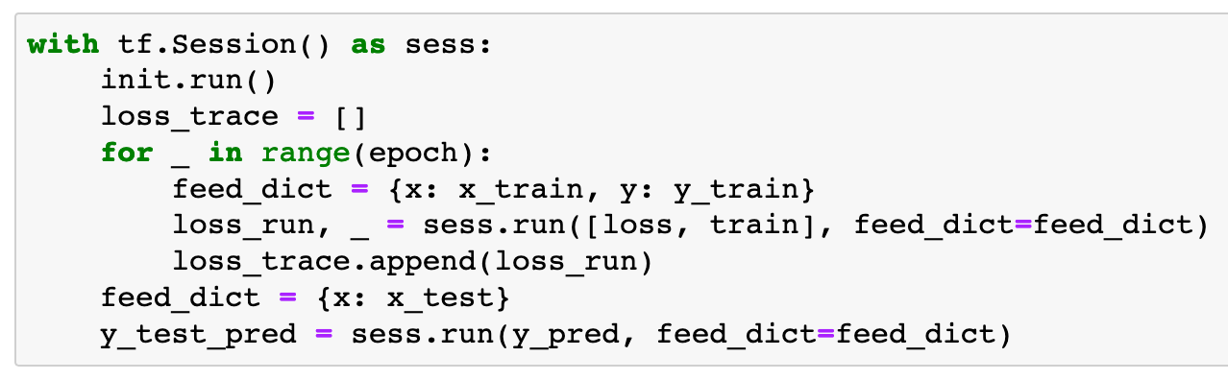

Slide 18
Report

Slide 19
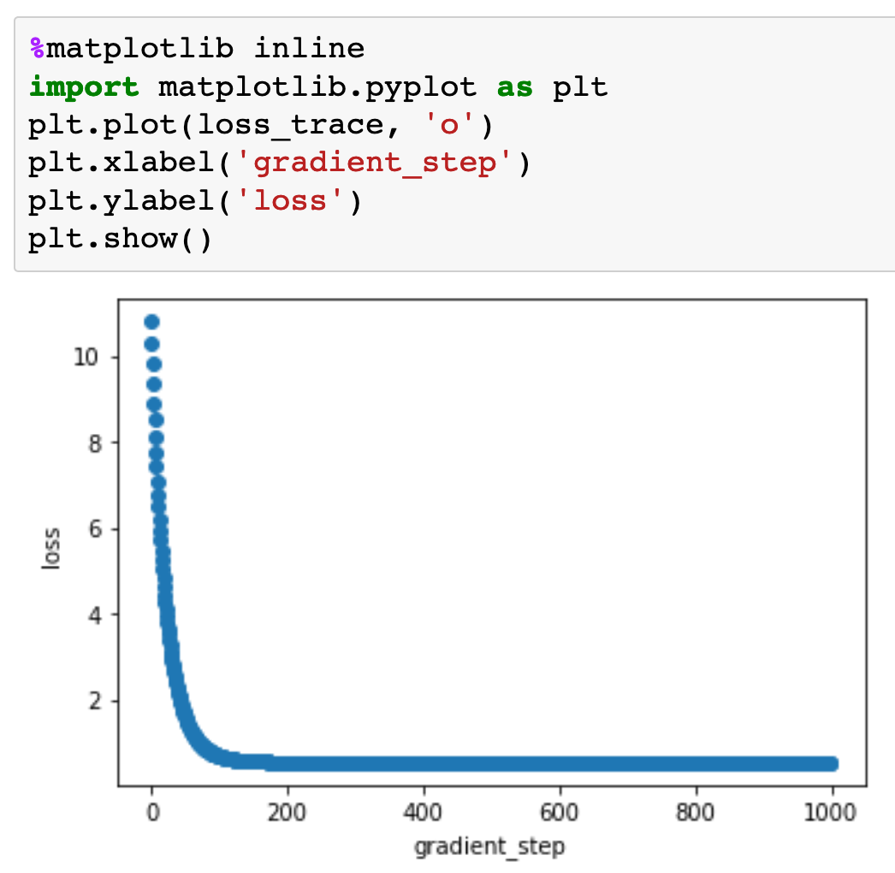

Slide 20
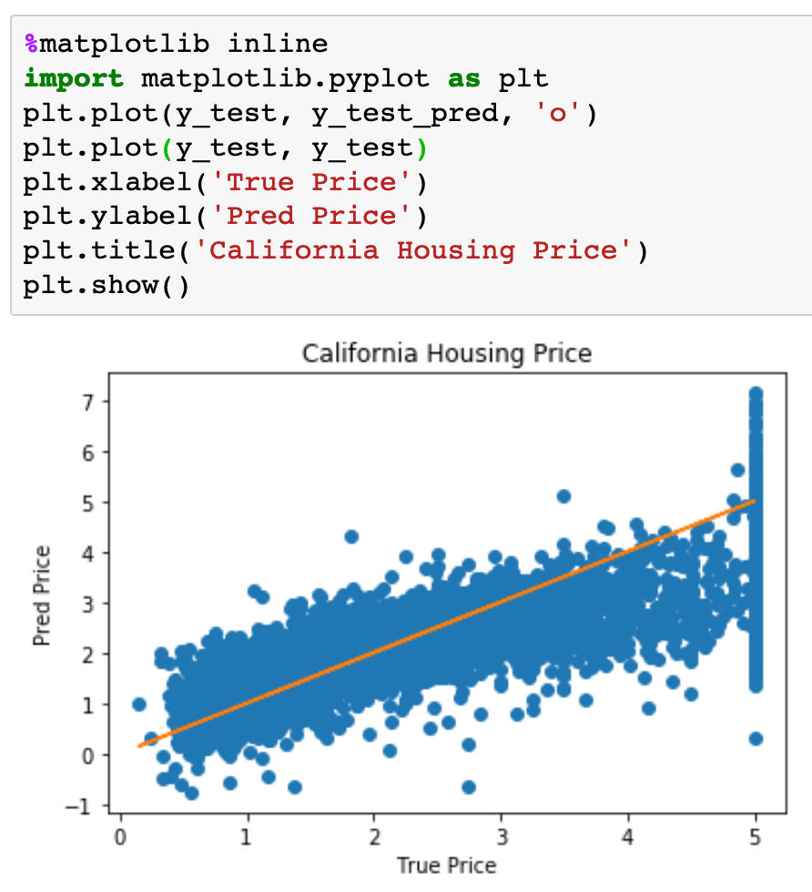

Slide 21
Now
Let’s Play with Code

